Slide 1
Classification and Prediction
Bayesian classification

Slide 2
Classification and Prediction
Basic Concepts
Issues Regarding Classification and Prediction
Decision Tree
Bayesian Classification
Neural Networks
Associative classification
Classification Accuracy

Slide 3
Bayesian Theorem: Basics
Let X be a data sample whose class label is unknown设X是类标号未知的数据样本
Let H be a hypothesis that X belongs to class C设H是一个假设，即X属于C类
对于分类问题, 确定 P(H|X):该假设拥有给定的被观察数据样本X的概率
P(H):假设H的先验概率(即在我们观察任何数据，反映背景知识之前最初的概率)
P(X): probability that sample data is observed观察样本数据的概率
P(X|H) : probability of observing the sample X, given that the hypothesis holds

Slide 4
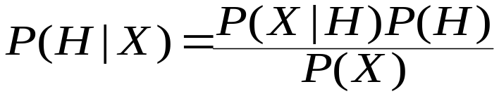
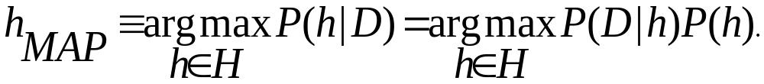
Bayesian Theorem
给定训练数据 X, 假设H的先验概率, P(H|X) 遵循贝叶斯定理
非正式的，这可以写成
  posteriori = likelihood x prior / evidence
MAP (maximum posteriori最大后验) 假设
实际困难: 需要许多概率，大量计算成本的初步知识

Slide 5

Naïve Bayes Classifier
一个简化的假设: 属性有条件的独立:
对于给定的当前类别C，两个因素y₁ 和 y₂,同时发生的概率，是每个因素单独发生的概率的乘积，P([y₁,y₂], C) = P(y₁, C) * P(y₂, C)
No dependence relation between attributes 属性之间没有依赖关系
Greatly reduces the computation cost, only count the class distribution.大大降低了计算成本，只计算类的分布
Once the probability一旦概率 P(X|C_{i})已知, 指定 X为有最大 P(X|C_{i}) * P(C_{i})值的类别

Slide 6
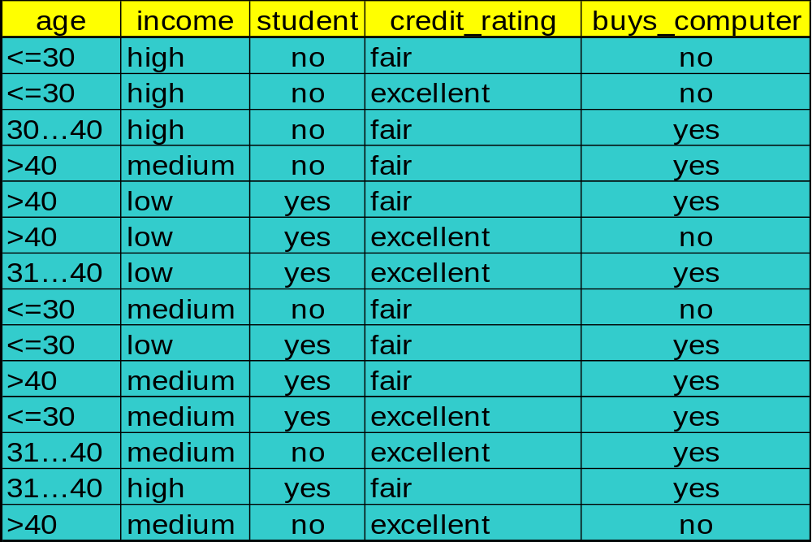
Training dataset
Class: C1: buys_computer=‘yes’; C2: buys_computer=‘no’
Data sample数据样本:
  X =(age<=30, Income=medium, Student=yes, Credit_rating= Fair)

Slide 7
Naïve Bayesian Classifier: An Example
计算每个类别的P(X|Ci)
P(age=“<30” | buys_computer=“yes”) = 2/9=0.222
P(age=“<30” | buys_computer=“no”) = 3/5 =0.6
P(income=“medium” | buys_computer=“yes”)= 4/9 =0.444
P(income=“medium” | buys_computer=“no”) = 2/5 = 0.4
P(student=“yes” | buys_computer=“yes)= 6/9 =0.667
P(student=“yes” | buys_computer=“no”)= 1/5=0.2
P(credit_rating=“fair” | buys_computer=“yes”)=6/9=0.667
P(credit_rating=“fair” | buys_computer=“no”)=2/5=0.4
X=(age<=30 , income =medium, student=yes, credit_rating=fair)
P(X|Ci) : P(X|buys_computer=“yes”)= 0.222 x 0.444 x 0.667 x 0.0.667 =0.044
P(X|buys_computer=“no”)= 0.6 x 0.4 x 0.2 x 0.4 =0.019
P(X|Ci)*P(Ci ) : P(X|buys_computer=“yes”) * P(buys_computer=“yes”)=0.028
P(X|buys_computer=“no”) * P(buys_computer=“no”)=0.007
Therefore, X belongs to class “buys_computer=yes”

Slide 8
Naïve Bayesian Classifier: Comments
优点
  容易实现
  在大多数情况下获得了良好的效果
缺点
  假设：类条件独立性，因此损失了准确性
  实际上，变量之间攒竹依赖性，例如，医院：病人：病人个人资料：年龄，家族历史等
  症状：发热，咳嗽等。疾病：肺癌，糖尿病等
  朴素贝叶斯分类器不能模拟其中的依赖性
如何处理这些依赖性?
  贝叶斯信念网络

Slide 9
Bayesian Belief Networks
贝叶斯信念网络允许一个变量的子集有条件的独立
因果关系的图形模型
  表示变量间的依赖性
  给出了一个规范的联合概率分布
Nodes节点:随机变量 random variables
Links联系:依赖项 dependency
X,Y 是Z的父母, Y是P的父母
Z和P没有依赖性
Has no loops or cycles没有循环或周期
X
Y
Z
P

Slide 10
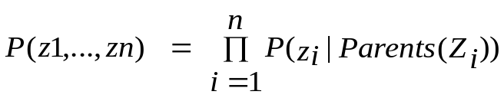
Bayesian Belief Network: An Example
Family
History
Smoker
(FH, S)
(FH, ~S)
(~FH, S)
(~FH, ~S)
LC
0.8
0.5
0.7
0.1
LungCancer
Emphysema
（肺气肿）
~LC
0.2
0.5
0.3
0.9
肺癌变量的条件概率表:
显示了它的父母每个可能组合的条件概率
PositiveXRay
Dyspnea
(呼吸困难)
Bayesian Belief Networks

Slide 11
Learning Bayesian Networks
Several cases几个例子
  Given both the network structure and all variables observable: learn only the CPTs给定可观察的网络结构和所有变量：学习CPTs
  已知网络结构，一些隐藏的变量：梯度下降法，类似于神经网络学习
  网络结构未知，所有变量可观察：搜索模型空间，重建图形拓扑
  Unknown structure, all hidden variables: no good algorithms known for this purpose结构未知，所有变量隐藏：为此没有好的算法
D. Heckerman,数据挖掘的贝叶斯网络http://research.microsoft.com/adapt/MSBNx/

